Slide 1

Development Services – Training Course
IT 10069 QuickTest Professional [QTP] & Automated Business Process Testing [BPT]
Notes:
Course Prerequisites
Familiarity with ATC Terms and Definitions
Familiarity with ATC Roles and Responsibilities
ATC Training – Methodology
Copy handouts
Defect Management and Reporting document

Slide 2
Agenda
Business Process Testing Overview
  Role Based Process
  Types of Components
Working with Parameters
  Types of Parameters
Creating Business Process Tests
Creating Run-Time Parameters
Connecting QTP to QC
Understanding the Application Area
  What is a Function Library?
  What is a Recovery Scenario?
  Creating a New Application Area
  Creating a New Shared Object Repository
Automating Components
Executing Automated Business Process Tests
125

Slide 3
Agenda
Business Process Testing Overview
  Role Based Process
  Types of Components
Working with Parameters
  Types of Parameters
Creating Business Process Tests
Creating Run-Time Parameters
Connecting QTP to QC
Understanding the Application Area
  What is a Function Library?
  What is a Recovery Scenario?
  Creating a New Application Area
  Creating a New Shared Object Repository
Automating Components
Executing Automated Business Process Tests
126

Slide 4
HP Business Process Testing
The business centric platform for functional testing
Manual tests
Automated scripts
Doc and reporting
Business Process Testing
Managed for
change
Role
based
Web
based
127

Slide 5

HP Quality Center 10.0
HP Quality Center™
Dashboard (Cross Project Reporting)
Quality Center
Requirements
Management
Test Design
Test Execution
Defect
Management
Project Reporting
Risk Mitigation & Management
Release &
Testing Cycle Management
Versioning & Baseline
Traceability Matrix
Business Process Testing (Design, Development, & Execution)
Performance Center
QuickTest
Professional
Manual
Scripts
Scenarios
Testing Results
Foundation
Shared Data Repository
Central Administration
Workflows
Open APIs
128
Notes:
BPT:
Add-in to QC
Role-based test design
Enables Test Designer to create business process tests early in the development cycle using business components in a script-free environment.
Components can be created within the Test Plan or Business Components module

Slide 6
What is a Business Process Test?
A Business Process Test is a scenario comprised of a serial flow of
business components, designed to test a specific business process of the
AUT.
Business Process Tests are assembled in Quality Center (QC) Test Plan module.
Existing components can be selected from a Tree view, or new components can be created.
Components are assembled in the order necessary to test the process.
The same component can exist in one or more test cases.
129

Slide 7
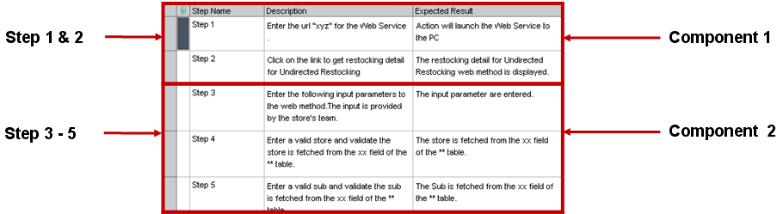
What is a Business Component?
A Business Component is a reusable unit comprising one or more steps
that perform a specific task. Components are the building blocks of
business process testing.
130

Slide 8
Types of Components
Manual Component
  A non-automated business component.
Scripted Component
  An automated component that can contain programming logic and can be edited in QTP Expert View.
Keyword Component
  An automated business component created using the Keyword View (not used at XYZ).
131
131

Slide 9


Role Based Process
Test Designer defines manual components
Test Executer runs the tests in QC Test Lab module, either manually or through automated execution
Test Automation Engineers automate manual components using VBScript
Test Automation Engineers enable automated components by adding detailed validations, error handling, reporting, etc.
132

Slide 10
Traditional Test Design Methodology: Serial Testing
Create Reservation
Delete Reservation
Update Reservation
Login
Login
Login
Search
Reservation
Search
Reservation
Create
Reservation
Delete
Reservation
Update
Reservation
View
Reservation
View
Reservation
View
Reservation
Logout
Logout
Logout
133
Notes:
Here I want to give you a sense for what a component is and what a business process test would look like. A component is a user defined piece of an application function or business function that performs a specific task within an application or an entire business process.

Slide 11
New Test Design Methodology: Business Process Testing
Login
Create
Reservation
View
Reservation
Search
Reservation
Delete
Reservation
Update
Reservation
Logout
Create Reservation
Delete Reservation
Update Reservation
Test Data
Reduce test creation and maintenance time
134
Notes:
Reuse Components in Multiple Test Cases

Slide 12
Agenda
Business Process Testing Overview
  Role Based Process
  Types of Components
Working with Parameters
  Types of Parameters
Creating Business Process Tests
Creating Run-Time Parameters
Connecting QTP to QC
Understanding the Application Area
  What is a Function Library?
  What is a Recovery Scenario?
  Creating a New Application Area
  Creating a New Shared Object Repository
Automating Components
Executing Automated Business Process Tests
135

Slide 13

What is a Parameter?
Parameters are variables that are assigned a value. QTP enables the scope of a
basic test to be expanded by replacing fixed values with parameters. This process,
known as parameterization, enables the same operations to be performed on the AUT
using multiple sets of data, facilitating reusability.
Parameters greatly increase the power and flexibility of tests, flows and components.
Parameters are defined in the QC Business Components module Parameters tab, or created directly in the Design Steps tab.
Use parameters in the Design Steps Description instead of hard-coding values.
136

Slide 14
Types of Parameters
Input parameters are values that a business component can receive and use, enabling a test to be run using different sets of input data.
An input parameter can receive:
  a predefined default value, if no other value is supplied by the test or flow.
  an output parameter value returned by a component or flow earlier in the test.
  a parameter value that is supplied at the test level (run-time).
Output parameters are values that a business component can capture during run-time. Output parameters allow data values retrieved from a component step or flow (the source) to be passed as input parameters to a subsequent component or flow (the target) in the test run.
Run-time parameters (sometimes referred to as global input parameters) are values that vary at run-time. Run-time parameters allow a test to run multiple times or iterations. For each iteration that the test executes, it sends different values for each run-time parameter.
137

Slide 15
Hands-On: Creating Manual Components (1 of 2)
Create the following six(6) manual components for the Mercury Tours
application. These components will be automated later.
Launch
Summary: Launches Internet Explorer and types the requested URL.
Parameters:
p_Launch_URL (String); Default Value: newtours.demoaut.com
MT_SignIn
Summary: Enter Sign-In details on the Mercuy Tours "Welcome" page.
Pre-Condition: "Welcome" page is displayed
Post-Condition: "Flight Finder" page is displayed
Parameters:
p_SignIn_UserName (String); Default Value: tutorial
p_SignIn_UserPassword (Password): Default Value: tutorial
138
Notes:
a

Slide 16
Hands-On: Creating Manual Components (2 of 2)
MT_FindFlight_Input
Summary: Enter flight details on the Mercury Tours "Flight Finder" page.
Pre-Condition: "Flight Finder" page is displayed
Post-Condition: "Select Flight" page is displayed
Parameters: There are ten(10) input parameters. Create at least three(3), for example:
  p_Find_FlightType
  p_Find_NbrPassengers
  p_Find_DepartureCity
Continue building MT_SelectFlight_Input, MT_BookFlight_Input, and MT_ConfirmFlight_Verify components.
Select component does not have any input parameters.
Book component has at least 25 input parameters. Create at least three(3) in your component.
Confirm component does not have any input parameters. Create an output parameter for the Order Number.
139
Notes:
a

Slide 17
Agenda
Business Process Testing Overview
  Role Based Process
  Types of Components
Working with Parameters
  Types of Parameters
Creating Business Process Tests
Creating Run-Time Parameters
Connecting QTP to QC
Understanding the Application Area
  What is a Function Library?
  What is a Recovery Scenario?
  Creating a New Application Area
  Creating a New Shared Object Repository
Automating Components
Executing Automated Business Process Tests
140

Slide 18

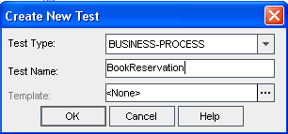

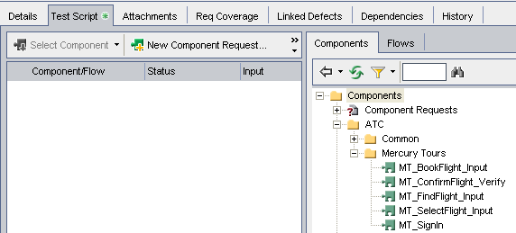
Creating Business Process Tests (1 of 5)
Select QC Test Plan module.
Select New Test.
Select an existing component or create a New Component Request.
Notes:
Test Type is “Business-Process”.
Test Names should be meaningful and consistent with standards adopted by your team.
On Details Tab, provide Free Form Text describing this Test Case
Test Type is

Slide 19
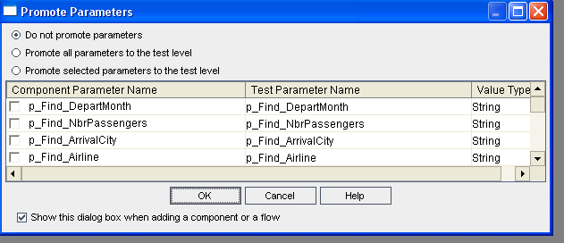
Creating Business Process Tests (2 of 5)
When adding a component or flow to the Test Case, the Promote Parameters dialog box is displayed.
142

Slide 20
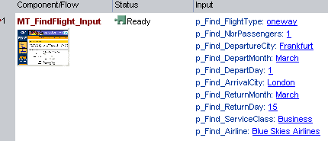
Creating Business Process Tests (3 of 5)
If Do not promote parameters is selected, run-time parameters are not created. The parameter default value will be displayed if one was provided for the parameter.
143

Slide 21
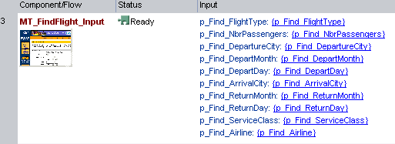
Creating Business Process Tests (4 of 5)
If Promote is selected for some or all of the parameters, the appropriate run-time parameters are created.
144
Notes:
Run-time parms are enclosed in curly brackets.

Slide 22
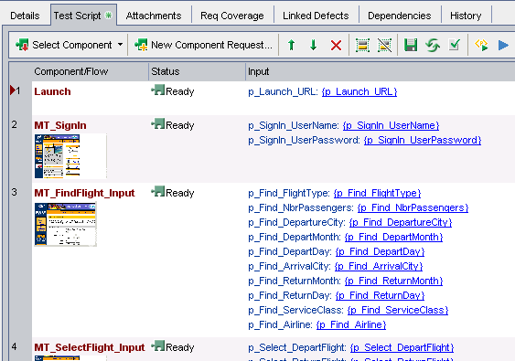
Creating Business Process Tests (5 of 5)
The completed Business Process Test contains the selected components and run-time parameters.
145

Slide 23
Agenda
Business Process Testing Overview
  Role Based Process
  Types of Components
Working with Parameters
  Types of Parameters
Creating Business Process Tests
Creating Run-Time Parameters
Connecting QTP to QC
Understanding the Application Area
  What is a Function Library?
  What is a Recovery Scenario?
  Creating a New Application Area
  Creating a New Shared Object Repository
Automating Components
Executing Automated Business Process Tests
146

Slide 24

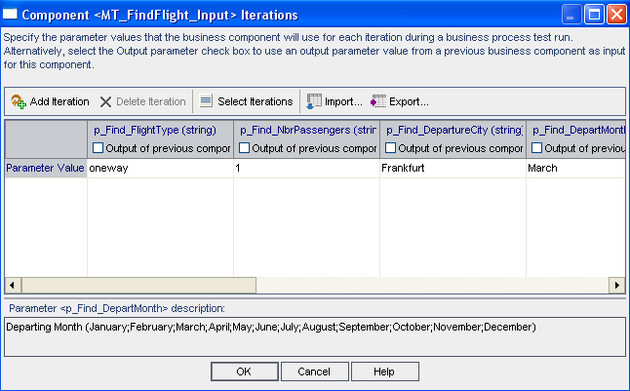
Creating Run-Time Parameters (1 of 2)
Click the parameter name in the Input column to display the Component Iterations window.

Slide 25
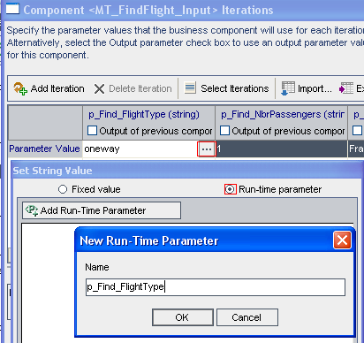
Creating Run-Time Parameters (2 of 2)
2. Define desired parameters as run-time.
148
Notes:
Run-time parms are enclosed in curly brackets.

Slide 26
Parameter Guidelines
  For each of the parameters defined in the components and flows, decide if:
  the value is determined within the test (either as a fixed value or as a value returned by a previous component or flow).
  the value is specified at the time of the test run.
  Note that a combination can be used. Consider the following:
Component or Flow Input Parameters | Run-time Parameters
1. Allow multiple iterations of a component or flow. | 1. Allow multiple iterations of an entire business process test or flow, with different values in each iteration.
2. Values are defined in the Test Plan module. | 2. Values are defined in the Test Lab module.
3. The test always runs with the same data. | 3. The test can run with varying data defined at run-time.
4. May require maintenance to existing flows or tests to set parameter value. Using a parameter default value may help to reduce this effort. | 4. May require maintenance to existing flows or tests to promote the parameter to run-time.
 | 5. Avoid when there is a high component to test ratio and likely probability of change to component parameters.
149
149

Slide 27
Hands-On: Creating a Business Process Test
Use the manual components you created previously to build a BookReservation
Business Process Test.
Launch (do NOT promote parameters)
MT_SignIn
MT_FindFlight_Input
MT_SelectFlight_Input
MT_BookFlight_Input
MT_ConfirmFlight_Verify
Promote all parameters to the test level except on the Launch component.
On the Launch component, Do not Promote.
What is different about the p_Launch_URL parameter compared to the other parameters?
Now make the p_Launch_URL parameter run-time.
150
Notes:
a

Slide 28
Agenda
Business Process Testing Overview
  Role Based Process
  Types of Components
Working with Parameters
  Types of Parameters
Creating Business Process Tests
Creating Run-Time Parameters
Connecting QTP to QC
Understanding the Application Area
  What is a Function Library?
  What is a Recovery Scenario?
  Creating a New Application Area
  Creating a New Shared Object Repository
Automating Components
Executing Automated Business Process Tests
151

Slide 29
Connecting QTP to QC (1 of 6)
To work with business process tests, QuickTest must be connected to the QC server
on which the QC project is stored. The connection process has two stages:
Connect QuickTest to a local or remote QC server. This server handles the connections between QuickTest and the QC project.
Log in and choose the project QuickTest is to access. The project stores tests and runs session information for the AUT. Note that QC projects are password protected, so provide your user name and password.
Before QTP can create and save BPT files into QC, the QuickTest Professional for Business Process Testing Add-in must be installed. The add-in can be found on the QC Add-Ins page.
Note: The functionality provided by the QuickTest Professional for Business Process Testing Add-in is included in the QuickTest Add-in for Quality Center that is installed with QTP. If you have already installed QTP on your QC client machine, you do not need to install this add-in.
152

Slide 30
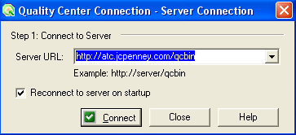
Connecting QTP to QC (2 of 6)
Select File > Quality Center Connection or click the Quality Center Connection toolbar button. The Quality Center Connection - Server Connection dialog box opens.
To automatically reconnect to the QC server the next time QuickTest is opened, select the Reconnect to server on startup check box.
153

Slide 31
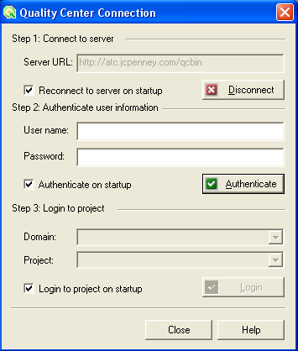
Connecting QTP to QC (3 of 6)
Click Connect. The Quality Center Connection dialog box opens.
154

Slide 32
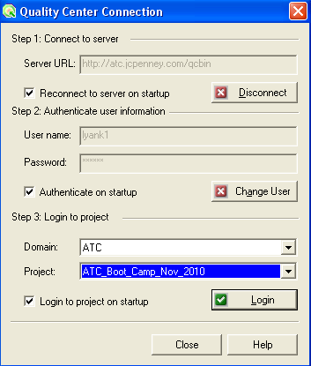
Connecting QTP to QC (4 of 6)
In the User name box, type your QC User name.
In the Password box, type your QC Password.
Click Authenticate to authenticate your user information against the QC server. After the user information is authenticated, the edit boxes in the Authenticate user information area are displayed in read-only format. The Authenticate button changes to a Change User button.
155

Slide 33
Connecting QTP to QC (5 of 6)
In the Domain box, select the domain that contains the QC project. Only those domains that you have permission to connect to are displayed.
In the Project box, select the desired project. Only those projects for which you are a defined user are displayed.
Click Login.
156

Slide 34
Connecting QTP to QC (6 of 6)
QTP then connects to QC.
Click Close to close the Quality Center Connection dialog box. The Quality Center icon is displayed on the status bar to indicate that QuickTest is currently connected to a Quality Center project.
  Tip: To view the current Quality Center connection, point to the Quality Center icon on the status bar. A tooltip displays the Quality Center server name and project to which QuickTest is connected. To open the Quality Center Connection dialog box, double-click the Quality Center icon.
157

Slide 35
Hands-On: Connect QTP to QC
Launch QTP.
Connect to the Training Quality Center project.
158

Slide 36
Agenda
Business Process Testing Overview
  Role Based Process
  Types of Components
Working with Parameters
  Types of Parameters
Creating Business Process Tests
Creating Run-Time Parameters
Connecting QTP to QC
Understanding the Application Area
  What is a Function Library?
  What is a Recovery Scenario?
  Creating a New Application Area
  Creating a New Shared Object Repository
Automating Components
Executing Automated Business Process Tests
159

Slide 37
What is an Application Area? (1 of 2)
An application area is:
a collection of settings and resource files that are required to create the content of a business component.
a link between the component and its resources.
created using QTP and saved into QC.
not visible from the QC tree views as an asset or resource.
160
160
Notes:
Application area settings include general information about the application area, such as its name, description, associated QuickTest add-ins, and the applications on which associated components can run.
Application area resources include shared object repositories, function libraries, and so on. (You will learn about these types of resources in later topics.)
You store all of the resource files for an application area in Quality Center. To do this, you need to connect to a Quality Center project.
Depending on the application being tested, you may need to create one or multiple application areas. A good rule of thumb is to create one application area for each process that a Subject Matter Expert may need to test. (You may need to work with Subject Matter Experts to determine exactly what resources and settings are needed for each application area.)

Slide 38
What is an Application Area? (2 of 2)
Object Repository
Components
Function Libraries
Application
Area
Recovery Scenarios
Associated Add-ins
161

Slide 39
Associating an Application Area
    Manual components are created in QC and are not associated with an
    Application Area.
Scripted (automated) components must be associated with an Application Area.
Components are associated with only one Application Area.
A project can have multiple Application Areas.
162

Slide 40
Application Area Scope
Application Areas are designed to be flexible:
  Application Area for entire AUT ** Best Practice **
  Application Area per functional module of AUT
  Application Area for each application window of AUT
163

Slide 41
What is a Function Library?
A Function is a reusable code “snippet” designed to perform a specific task. Functions
are grouped together and saved into a Function Library that can then be associated
with an Application Area.
There are two types of Function Libraries:
Predefined Function Libraries allow QTP to use built-in keywords and functions and should not be removed from the Application Area. These Function Libraries are associated to an Application Area by default.
User-defined Function Libraries contain custom functions that Automation Engineers develop for use by all components.
User-defined Function Libraries are:
  written in VBScript.
  reusable, modular code units that help minimize maintenance.
  saved in QC Test Resources module in the BPT Resources > Libraries folder (file extensions *.vbs, *.qfl, *.txt)
164

Slide 42
What is a Recovery Scenario? (1 of 2)
Recovery Scenarios are QTP processes which execute based on a trigger
exception behavior.
Recovery Scenarios are:
unexpected events that cannot be predicted in advance.
events that cannot otherwise be synchronized with a specific step in the component.
If it can be predicted that a certain error may happen at a specific point in the
component, handle that event directly within the component.
Enables specific error handling
Permits timing of the corrective operation with minimal resource usage
Benefits of Exception Handling:
Ensures the test runs to completion
Enables testing of positive and negative test data
** Note – exceptions can also be handled programmatically using conditional, Exit, or the On Error Resume Next statements **
165

Slide 43
What is a Recovery Scenario? (2 of 2)
A Recovery Scenario consists of the following:
Trigger Event: the event that interrupts the run session.
Recovery Operations: the operations to perform to enable QuickTest to continue running the component.
Post-Recovery Test Run Option: the instructions on how QuickTest should proceed after the recovery operations have been performed, and from which point in the component QuickTest should continue, if at all. For example, you may want to restart a component from the beginning, or continue with the next step in the component.
Select Resources > Recovery Scenario Manager to access a wizard that guides you
through the process of defining a Recovery Scenario.
166

Slide 44
Recovery Scenarios – Further Details
A Recovery Scenario:
is saved in a recovery scenario file (.qrs extension).
file is a logical collection of recovery scenarios, grouped according to specific requirements.
can be viewed in QC Test Resources module.
is associated with an Application Area.
A component can have any number of recovery scenarios associated with it. The
scenarios associated with a component can be prioritized to ensure that trigger events
are recognized and handled in the required order.
When an error occurs for a component that has recovery scenarios defined, QuickTest
looks for the defined trigger events that caused the error. If found, QuickTest performs
the corresponding recovery and post-recovery operations.
167

Slide 45
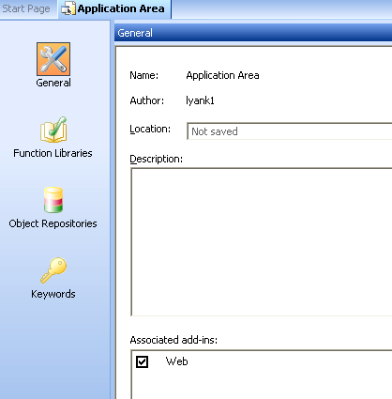
Creating an Application Area (1 of 3)
Launch QTP and connect to the desired QC project.
Open the Application Area window by selecting File > New > Application Area. The Application Area window contains several panes in which to specify the settings and resource files to be used by the Application Area.
168

Slide 46
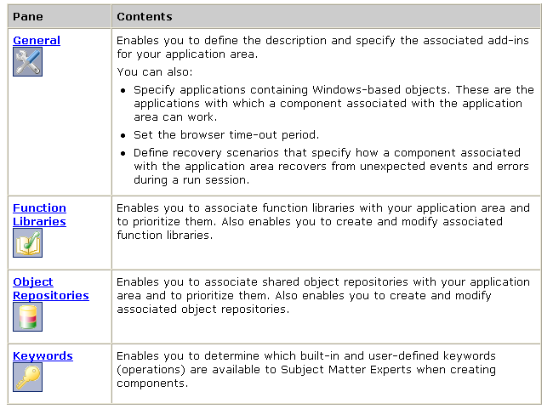
Creating an Application Area (2 of 3)
The Application Area contains the following panes which are accessed by clicking the appropriate button in the sidebar.
169

Slide 47
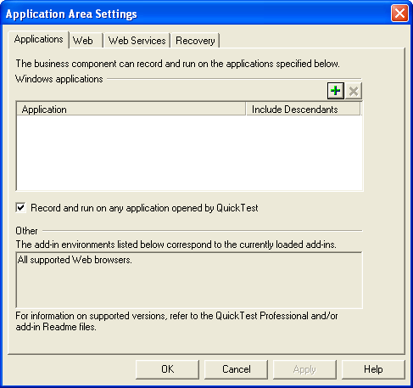
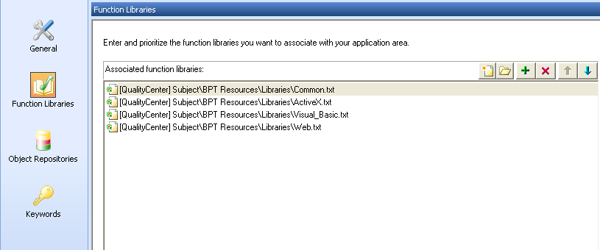
Creating an Application Area (3 of 3)
Specify the Application Area settings and define its resources.
Select File > Save to save the Application Area.
  When saving an Application Area, assign a unique name and provide a description if not done previously. A meaningful name and description enable the Test Automation Engineer to select the correct Application Area for a component.
170

Slide 48
Creating a New Shared Object Repository
A new shared object repository can be created directly from the Object Repositories
pane of the Application Area.
In QuickTest, open the Application Area (if it is not open). Select File > Open > Application Area. Click the Open button down arrow and select Application Area.
Click Object Repositories in the sidebar. The list of object repositories currently associated with the Application Area is displayed in the Object Repositories pane.
In the Object Repositories pane, click the Create Object Repository button. The Save Shared Object Repository dialog box opens.
In the sidebar, select the location of the file, for example, Quality Center Test Resources. Enter a name in File name box, and click Save.
  A new object repository is added to the selected location and is listed in the Object Repositories pane.
171

Slide 49
Hands-On: Working with the Application Area
Create an Application Area
  Name your Application Area “Mercury Tours_<Your CorpID>”
Create a Shared Object Repository
  Name your OR “MercuryTours_<Your CorpID>.tsr”
Associate the existing ATC_Generic function library to your Application Area
  Function Libraries +
Create a Recovery Scenario to handle IE crashing
Save your Application Area.
Export your local Object Repository from your recorded test
  Resources > Object Repository
  File > Export Local Objects
Upload this file to your shared Object Repository (this is done in QC)
  QC Test Resources module Resource Viewer tab
  Upload File
172

Slide 50
Agenda
Business Process Testing Overview
  Role Based Process
  Types of Components
Working with Parameters
  Types of Parameters
Creating Business Process Tests
Creating Run-Time Parameters
Connecting QTP to QC
Understanding the Application Area
  What is a Function Library?
  What is a Recovery Scenario?
  Creating a New Application Area
  Creating a New Shared Object Repository
Automating Components
Executing Automated Business Process Tests
173

Slide 51
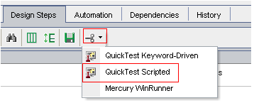
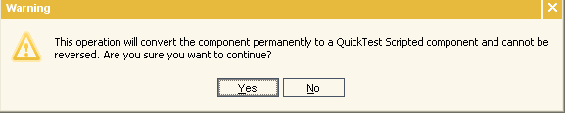
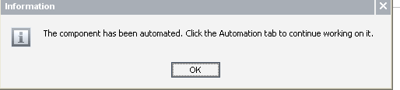
Automating Components (1 of 4)
In QC Business Components module, display the Design Steps tab and click the Automate component toolbar button.
  Select Quick-Test Scripted from the list and click Yes to the warning message.
  The component is converted. Click OK in the informational message.
174

Slide 52

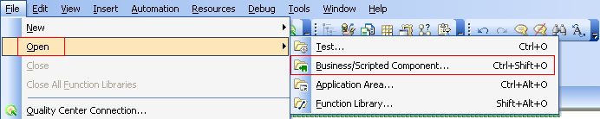
Automating Components (2 of 4)
Open the Business Component in QuickTest.
In QC Business Components module, display the Automation tab and select Launch.
In QTP, select File > Open > Business/Scripted Component

Slide 53
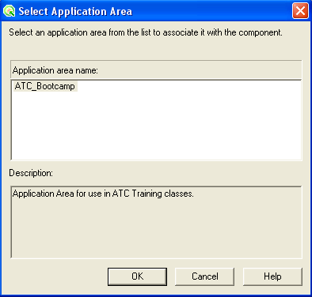
Automating Components (3 of 4)
The Select Application Area dialog box is displayed.
Select the desired Application Area and click OK. Save the component.
176

Slide 54
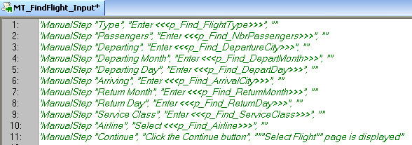
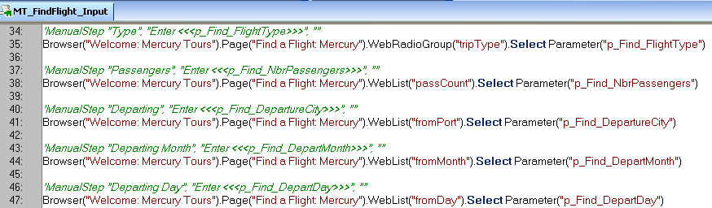
Automating Components (4 of 4)
Script the component in Expert View.
177

Slide 55
Hands-On: Automating Manual Components
Automate the manual components you created previously.
Launch
MT_SignIn
MT_FindFlight_Input
MT_SelectFlight_Input
MT_BookFlight_Input
MT_ConfirmFlight_Verify
Hints:
Copy the code from your recorded test into a text file for easy reference.
Code for Confirm component output parameter:
parameter("o_Confirm_OrderNbr") = trim(Browser("Welcome: Mercury Tours").Page("Flight Confirmation: Mercury").WebElement("Flight Confirmation #").GetROProperty("innertext"))
Associate the components with your Application Area.
The Launch component will have the following lines of code:
  SystemUtil.Run "C:\Program Files\Internet Explorer\IEXPLORE.EXE","-noframemerging"
  wait 5 'wait for the browser to load
  Browser("openedbytestingtool:= True").Navigate Parameter("p_Launch_URL")
For the other components, copy the appropriate lines of code from your recorded test. For example, the SignIn component will have 3 lines of code (set user name, set password, click sign-in).
Replace constant values with your input parameters. For example:
replace Set "tutorial“ with Set parameter("p_SignIn_UserName")
As you automate each component, make sure it executes successfully by running in QTP.
178
Notes:
a

Slide 56
Agenda
Business Process Testing Overview
  Role Based Process
  Types of Components
Working with Parameters
  Types of Parameters
Creating Business Process Tests
Creating Run-Time Parameters
Connecting QTP to QC
Understanding the Application Area
  What is a Function Library?
  What is a Recovery Scenario?
  Creating a New Application Area
  Creating a New Shared Object Repository
Automating Components
Executing Automated Business Process Tests
179

Slide 57
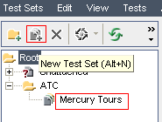
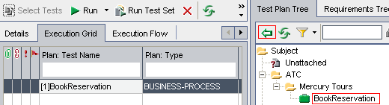
Executing Automated Business Process Tests (1 of 3)
In QC Test Lab module, select an existing test set or create a New Test Set.
2. Select Tests to add to the test set.
180
Notes:
Add a Test to your Test Set (double-click or drag to add the test to the execution grid)

Slide 58
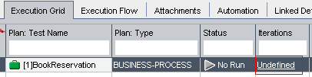
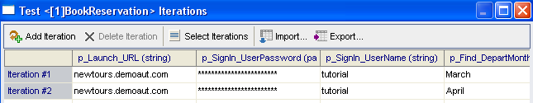
Executing Automated Business Process Tests (2 of 3)
3. Select Iterations and enter run-time data.
181

Slide 59
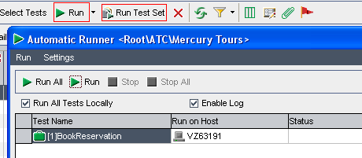
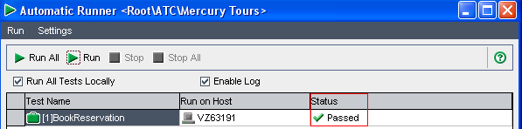
Executing Automated Business Process Tests (3 of 3)
Execute (run) desired test or test set.
Review execution status.
182

Slide 60

Hands-On: Execute the BookReservation Test
In Test Lab, create a new Test Set that contains your Business Process Test.
Enter values for your run-time parameters. Execute at least 2 iterations.
Run your test and review the results.
Troubleshoot if your test FAILED.
OBJECTIVE:
Congratulations on completing the course!
183
Notes:
a

Slide 61
IT 10069 DS QuickTest Professional [QTP] &
Automated Business Process Testing [BPT]
Q & A
184

